Slide 1
Sales of Company
Submitted by:
Shivani Adsar
Twinkle Inamdar

Slide 2
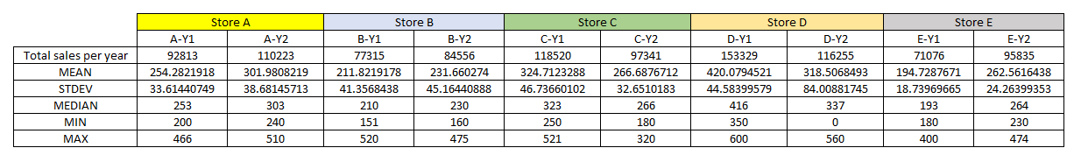
Comparison of Stores

Slide 3
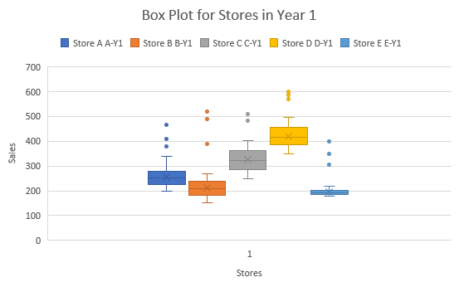
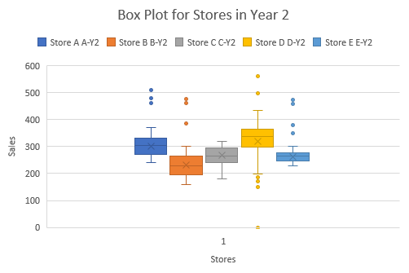
Box Plot for the Sales

Slide 4
Clustered Column Graph for the Sales

Slide 5
Conclusion
It is observed from the company's sales that using Box Plot we can represent the data more efficiently
Closing Store C and investing into Store D would be appropriate based on the minimum sales per year.
Since, the profitability of a store depends on various factors such as the demographics, I would not prefer closing any store and will try to incorporate the factors that lead to profitability of the store with highest revenue in the store having lowest revenue

Slide 6
Thank You

